Slide 1
Goals this Week
1. Understand how to use echo
2. Understand how to use variables and arrays

Slide 2
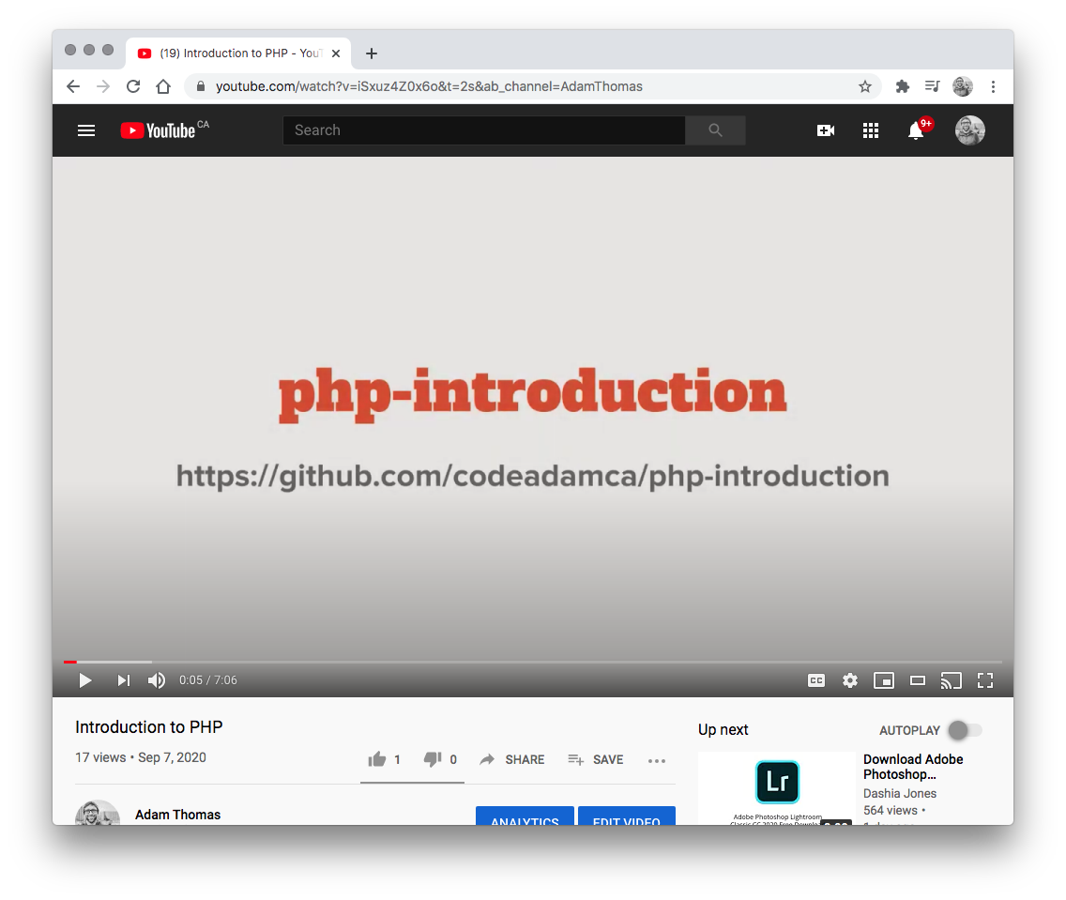

1. YouTube Videos
Watch the Following Youtube Videos:
PHP Output https://www.youtube.com/watch?v=lhRkHjqE9GQ
PHP Variables https://www.youtube.com/watch?v=fwWIKwF66IM
PHP Arrays, Forms, and Cookies https://www.youtube.com/watch?v=Vk_2yrazhjk

Slide 3
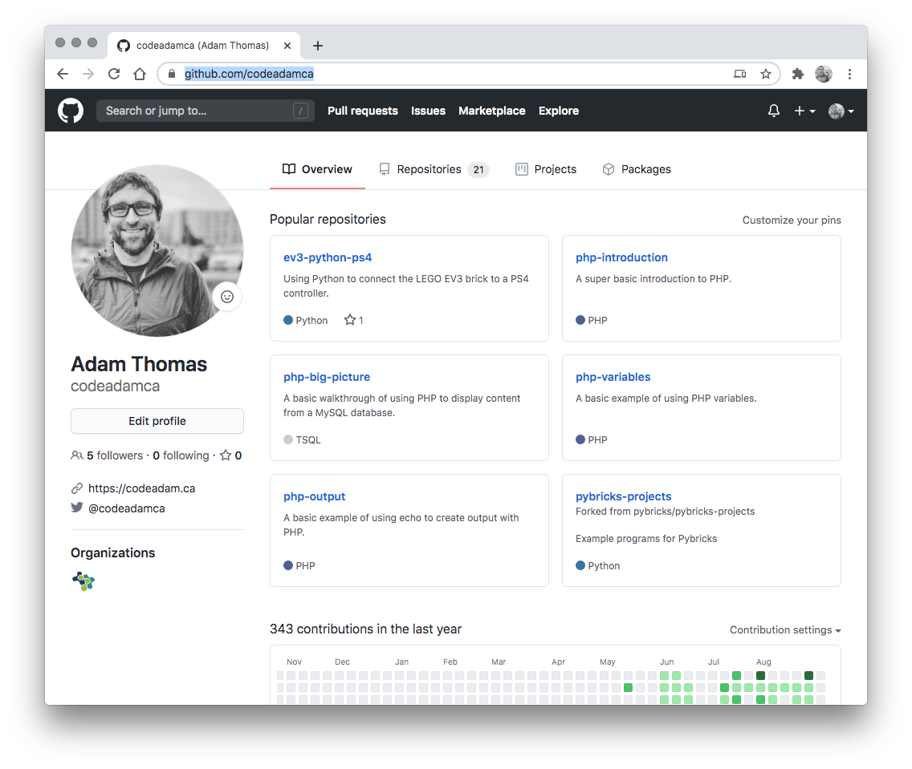

2. Review Code
Review the provided code and follow along with any coding instructions in GitHub:
PHP Output https://github.com/codeadamca/php-output
PHP Variables https://github.com/codeadamca/php-variables
PHP Arrays https://github.com/codeadamca/php-arrays
Optional
PHP Forms, Sessions, and Cookies: https://github.com/codeadamca/php-forms-sessions-cookies

Slide 4
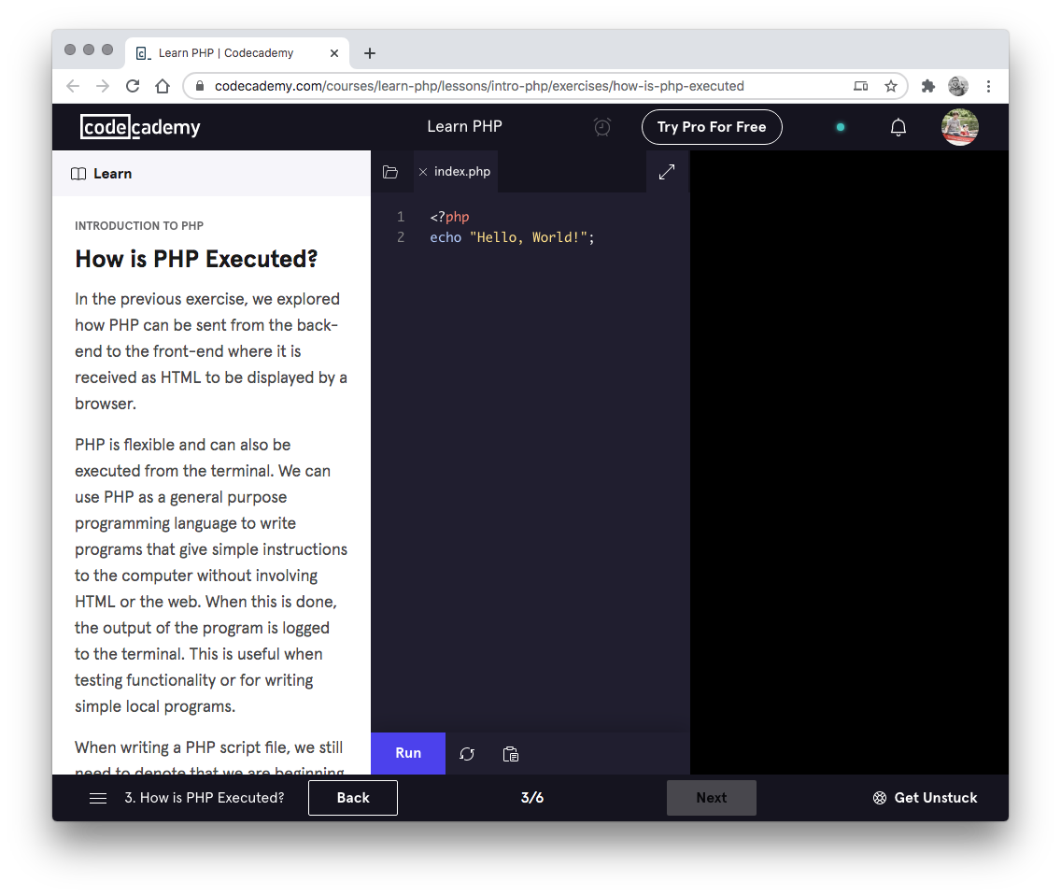

3. Codecademy
Complete the following Codecademy exercises:
Introduction to PHP: https://www.codecademy.com/learn/learn-php-introduction

